Slide 1
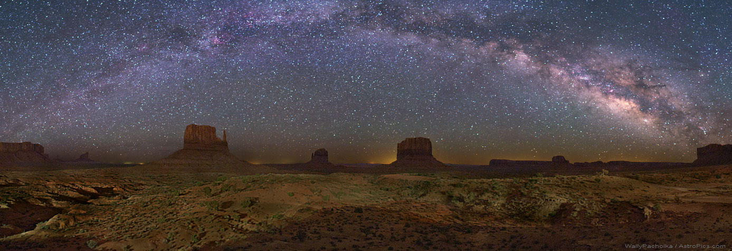



Nitrogen Fractionation in Prestellar Core L43(E)
Photo credit: APOD/NASA
Reynier Squillace
Mentor: Yancy Shirley
Arizona Space Grant Consortium
University of Arizona, Steward Observatory and Department of Astronomy

Slide 2
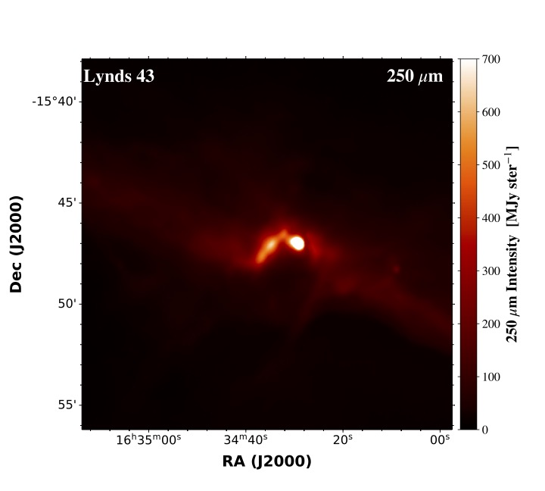
Prestellar Cores
Collapsing, bound, dense regions within molecular clouds
Future sites of star formation
Temperatures slightly hotter than 2.73K (CMB)

Slide 3
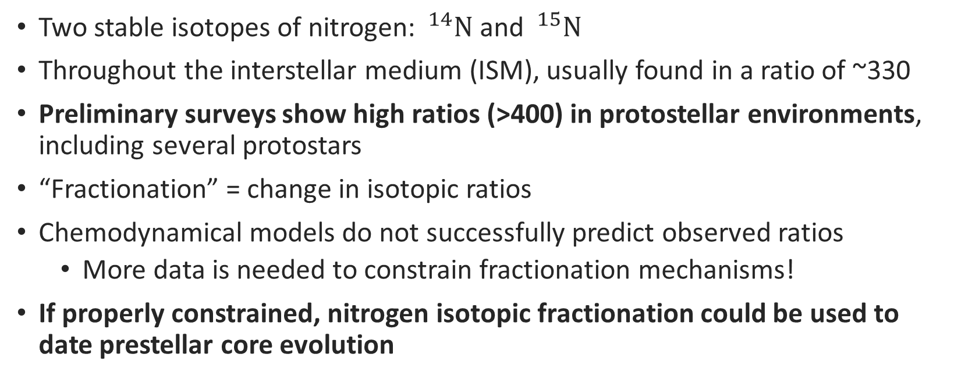
Nitrogen Fractionation
Two stable isotopes of nitrogen: $^{14}N$ and $^{15}N$
Throughout the interstellar medium (ISM), usually found in a ratio of ~330
Preliminary surveys show high ratios (>400) in protostellar environments, including several protostars
“Fractionation” = change in isotopic ratios
Chemodynamical models do not successfully predict observed ratios
  More data is needed to constrain fractionation mechanisms!
If properly constrained, nitrogen isotopic fractionation could be used to date prestellar core evolution

Slide 4
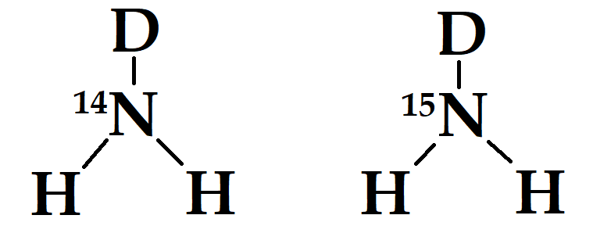

Deuterated Ammonia
Molecular nitrogen is abundant, but not easily observable (no permanent electric dipole moment)
Atomic nitrogen is abundant, but not easily observable (very low frequency)
So we use deuterated ammonia to determine the nitrogen fractionation ratio!
When the molecule transitions between different rotational states, it releases photons of discrete frequencies in a hyperfine pattern
…but only the hyperfine pattern of $^{14}{NH}_{2}D$ is resolvable!

Slide 5
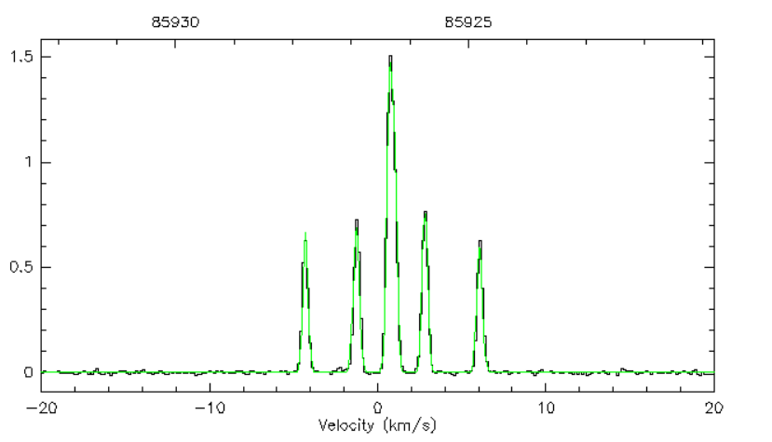
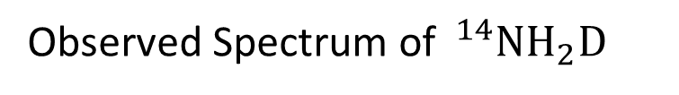
Observed Spectrum of $^{14}NH_{2}D$

Slide 6
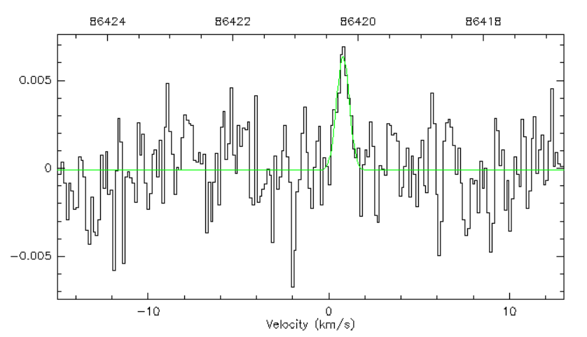
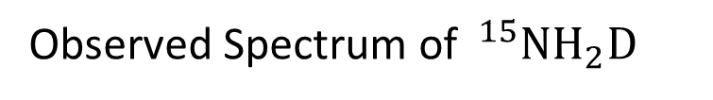
Observed Spectrum of $^{15}NH_{2}D$

Slide 7
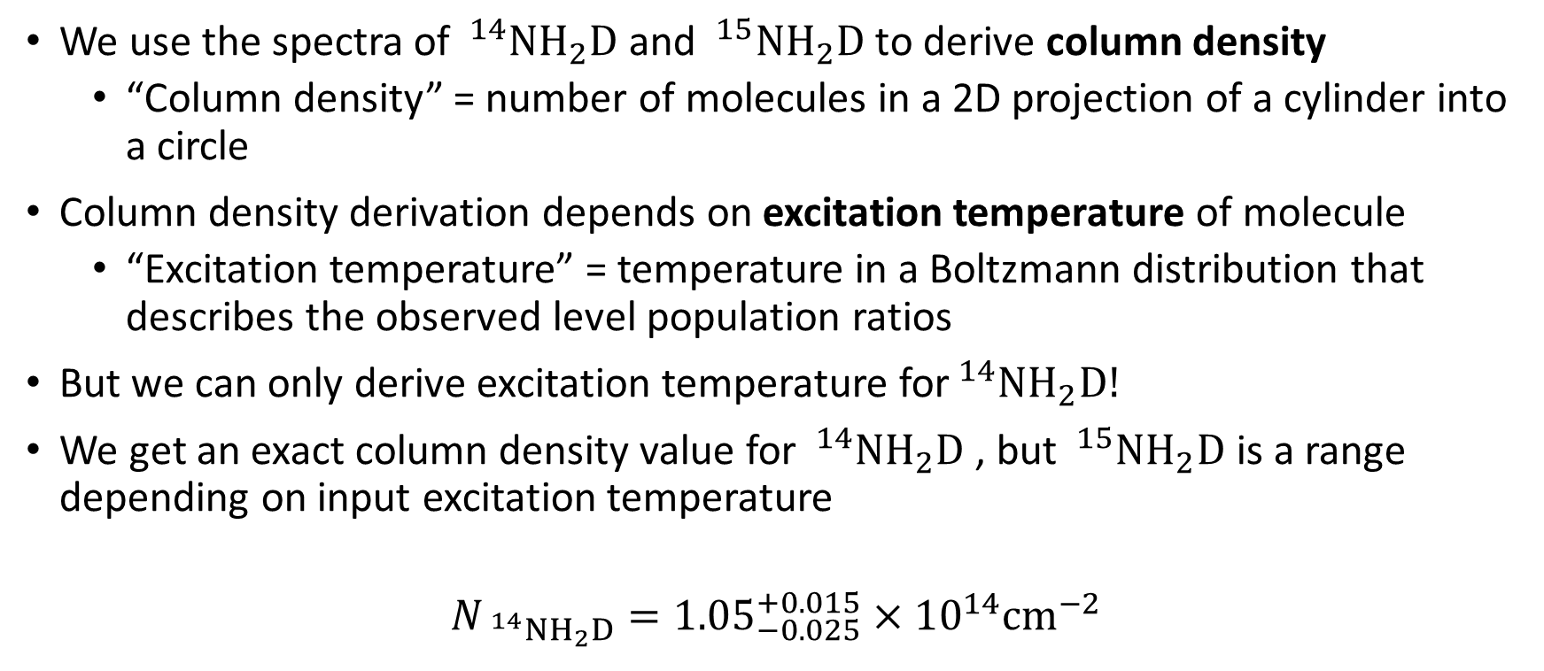
Methodology
We use the spectra of $^{14}{NH}_{2}D$ and $^{15}{NH}_{2}D$ to derive column density
  “Column density” = number of molecules in a 2D projection of a cylinder into a circle
Column density derivation depends on excitation temperature of molecule
  “Excitation temperature” = temperature in a Boltzmann distribution that describes the observed level population ratios
But we can only derive excitation temperature for$^{14}{NH}_{2}D!$
We get an exact column density value for $^{14}{NH}_{2}D$ , but $^{15}{NH}_{2}D$ is a range depending on input excitation temperature
$$N_{ ^{14}NH_{2}D}={1.05}_{−0.025}^{+0.015}×{10}^{14}cm^{−2}$$

Slide 8
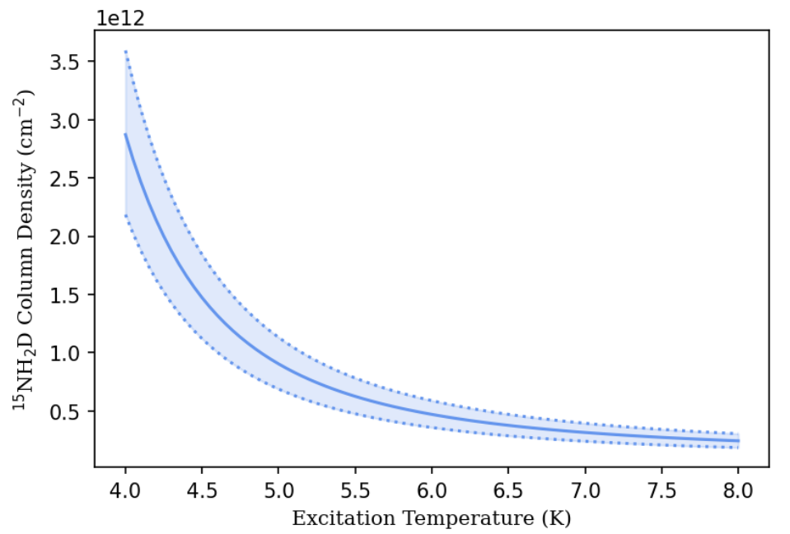

Slide 9

Ratio ~ 500!

Slide 10
But what if…

Slide 11
…our value was actually somewhere in here?

Slide 12
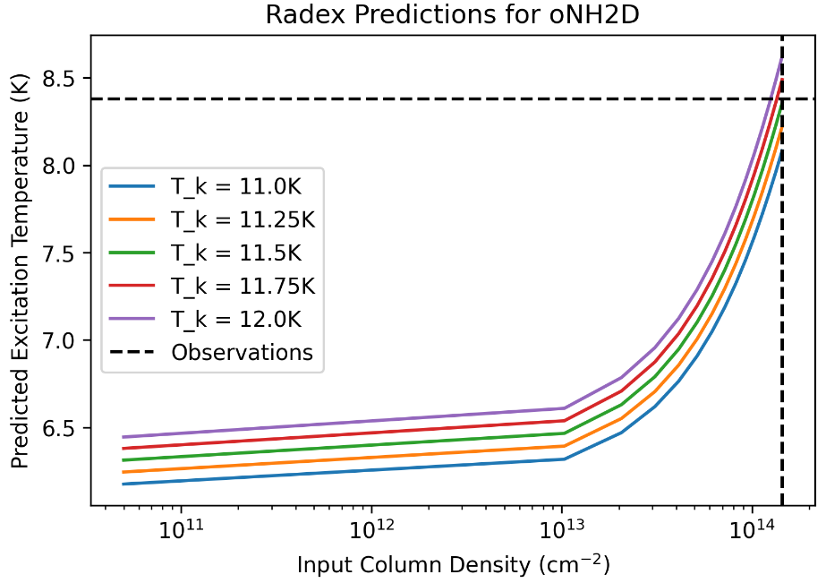

RADEX
RADEX is a radiative transfer code that allows us to predict the excitation temperature as a function of column density
Using the $^{14}{NH}_{2}D$ collision rates as a proxy, we can predict observed excitation temperature as a function of column density
The actual observed range of excitation temperatures for $^{15}{NH}_{2}D$ provides a viable range $6.3K≤T_{ex}≤6.6K$

Slide 13
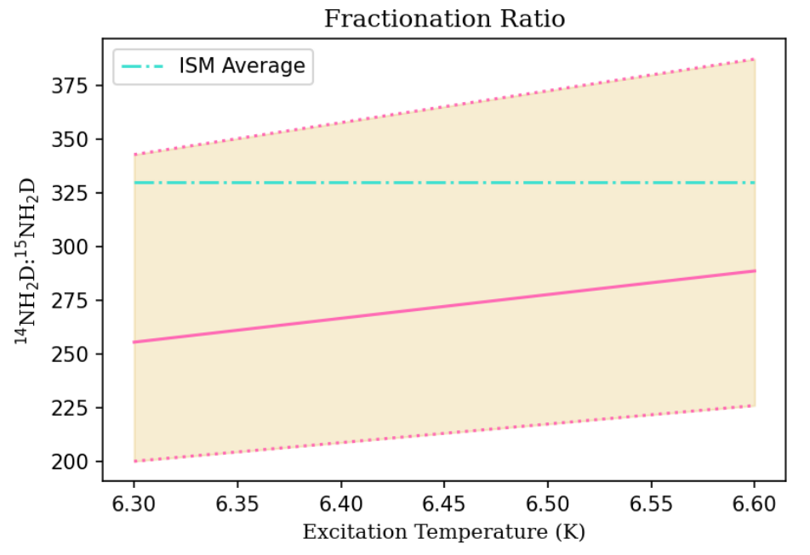

Slide 14
Anomalous core or anomalous methodology?

Slide 15
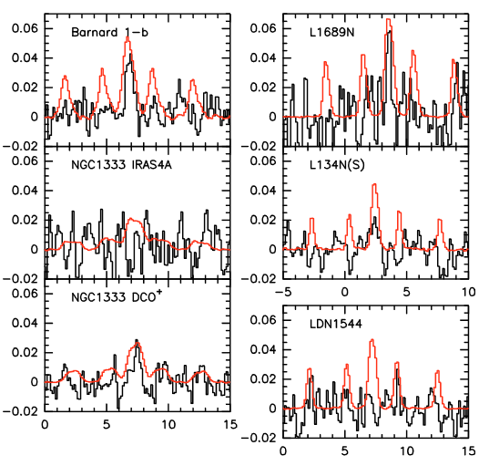
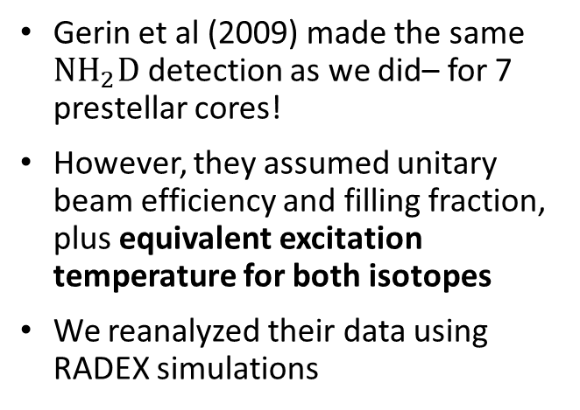
Let’s redo other people’s findings…
Gerin et al (2009) made the same $NH_{2}D$ detection as we did– for 7 prestellar cores!
However, they assumed unitary beam efficiency and filling fraction, plus equivalent excitation temperature for both isotopes
We reanalyzed their data using RADEX simulations
Main beam temperature versus velocity at the local standard of rest, from Gerin et al (2009)

Slide 16
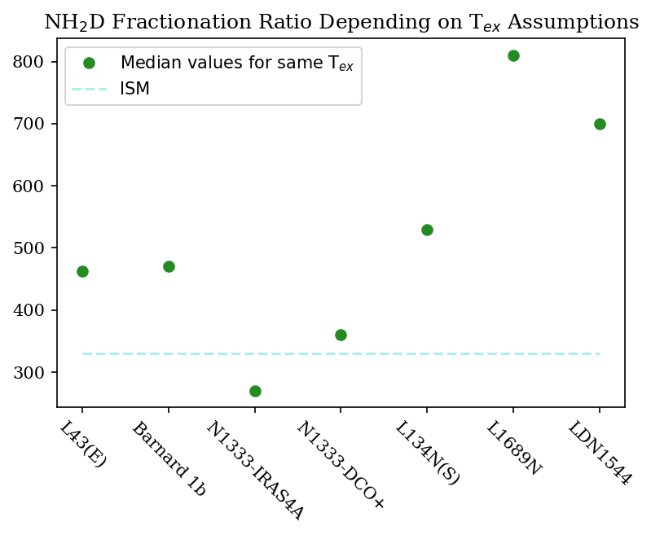

Slide 17
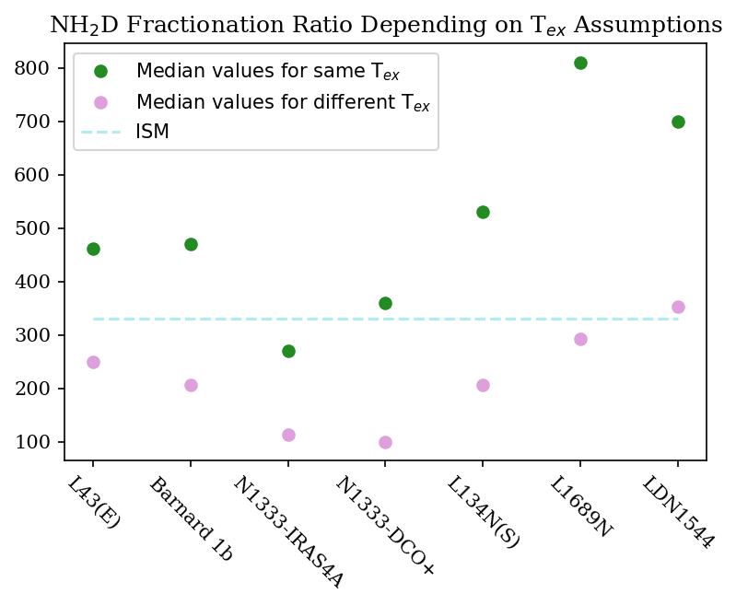

Slide 18
Results
Our findings do not support substantial nitrogen fractionation in L43E, although they do not entirely rule it out
This core is chemically evolved but dynamically younger (lower central density) than other surveyed cores
Prior surveys make several assumptions that may significantly impact results, including that excitation temperature for each isotope is the same.
We find that this may not be a valid assumption, indicating that fractionation may not be as substantial as previous findings show.

Slide 19
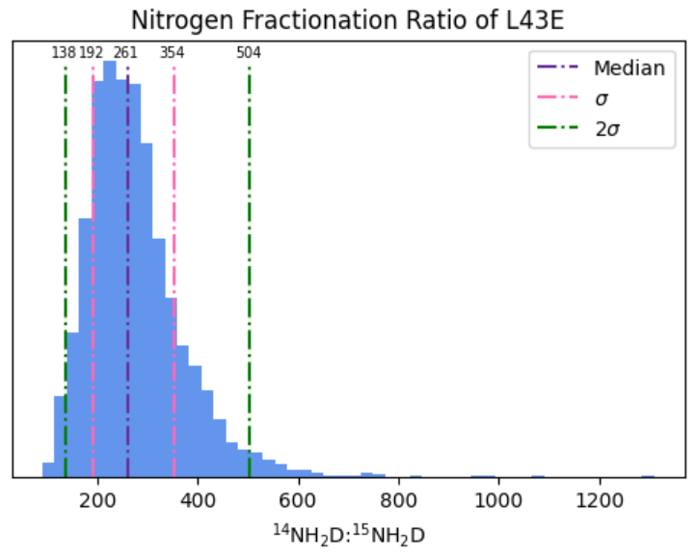
Future Work
We are working to perform Bayesian error propagation analysis
Running ratio algorithm for n = 10000 Gaussian random draws of parameters
Reevaluation of other sources using similar processes

Slide 20
Acknowledgements
Yancy Shirley
Michelle Coe and Chandra Holifield Collins
Arizona Space Grant Consortium
My research group: Sam Scibelli, Hanga Andras-Letanovsky, Hannah Gruber, and Aurora Wilde

